Slide 1
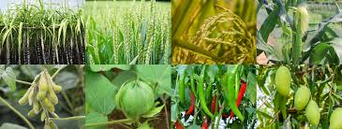
Crop Production Analysis in India
Ruby Varghese

Slide 2
Agenda
Problem Statement
Visualizations
Insights

Slide 3
Problem Statement
The Agriculture business domain, as a vital part of the overall supply chain, is expected to highly evolve in the upcoming years via the developments, which are taking place on the side of the Future Internet. This paper presents a novel Business-to-Business collaboration platform from the agri-food sector perspective, which aims to facilitate the collaboration of numerous stakeholders belonging to associated business domains, in an effective and flexible manner.
The objective of this project is to predict crop production and find important insights highlighting key indicators and metrics that influence crop production.

Slide 4
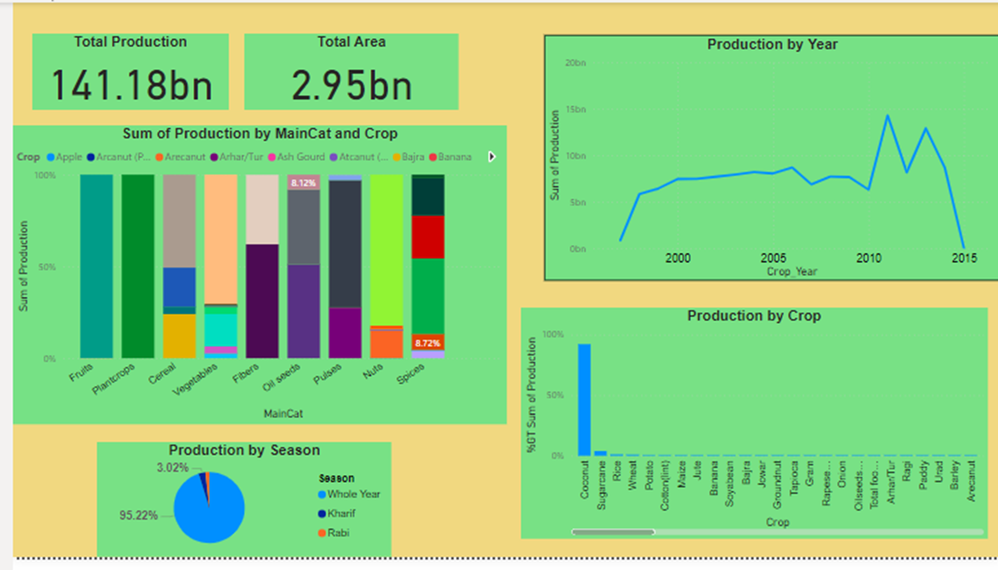

Slide 5
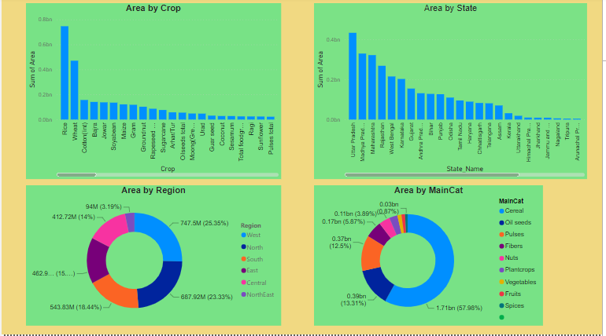

Slide 6
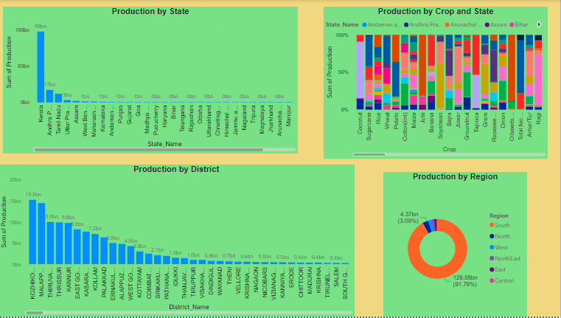

Slide 7
Insights
Total production of Coconut is highest among all Crops.
Top three crops by production are Coconut , Sugarcane and Rice.
Production is high in the year 2011.
Production is high in the ‘ whole year’ season.
Highest production from South region(91.79%) and then North(3.09%) and West(1.8%).
In south region highest production from Kerala (crop – Coconut).
In the district, highest production from Kozhikode.
More Area of production in Uttar Pradesh.
Rice cultivation occupies more land area compared to other crops.

Slide 8
THANK YOU

